Slide 1
Discussion Assignment #2
Due: October 4, 2019 @5pm (online submission)
For both questions:
Show your R code
State the outcome variable, grouping variable, H₀, H₁, critical t value, and your conclusion (i.e., reject or do not reject H₀, make a concluding sentence, and provide the P value if appropriate)
Questions:
Using Alldata_2019.csv,
Compare heart rate of female and male students
Check if the mean heart rate of male students is different from 65 BPM

Slide 2
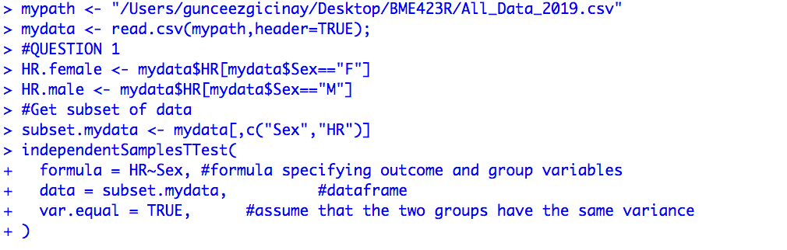
Discussion Assignment 2 - Answer Key - QUESTION 1

Slide 3
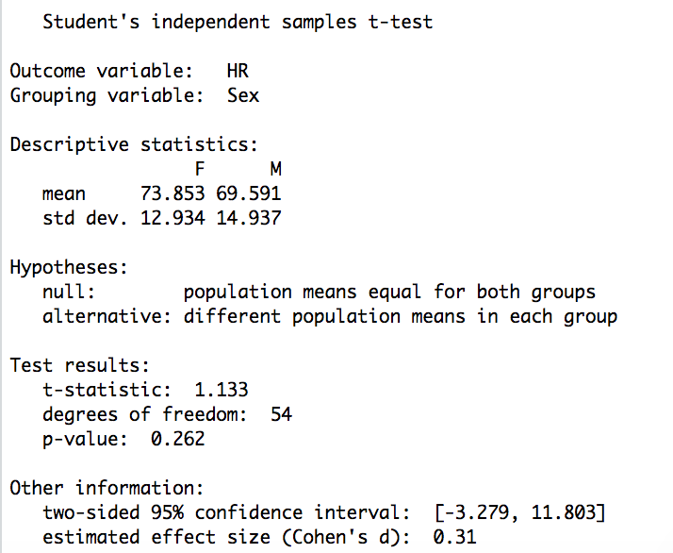
Discussion Assignment 2 - Answer Key - QUESTION 1

Slide 4
Discussion Assignment 2 - Answer Key - QUESTION 1
Outcome variable: Heart rate
Grouping variable: Sex
Null Hypothesis: Population means for heart rate are the same between female and male students.
Alternative hypothesis: Population means for heart rate are different between female and male students.
t_critical at significance level of 0.05 (t_0.05): 2.005
Conclusion: |t_calculated|=1.133 < t_critical=2.005 → Ho is not rejected. There is no statistically significant difference in the mean heart rates between female and male students.

Slide 5

Discussion Assignment 2 - Answer Key - QUESTION 2

Slide 6
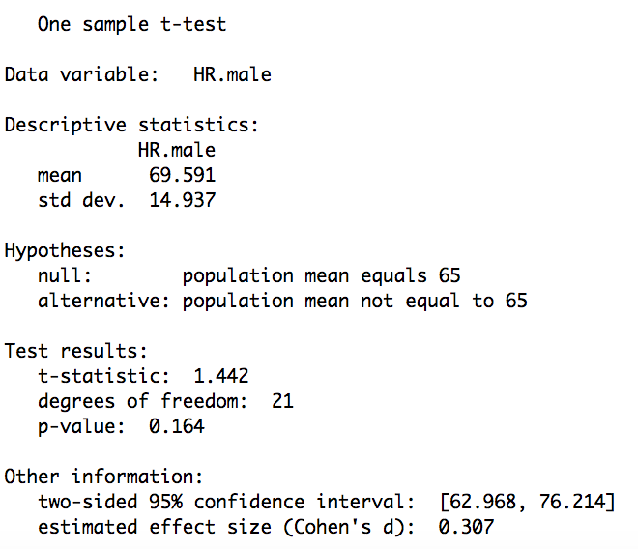
Discussion Assignment 2 - Answer Key - QUESTION 2

Slide 7
Discussion Assignment 2 - Answer Key - QUESTION 2
Outcome variable: Heart rate
Grouping variable: Male students
Null Hypothesis: Population mean of male students’ heart rates is equal to 65 BPM
Alternative hypothesis: Population mean of male students’ heart rates is different from 65 BPM
t_critical at significance level of 0.05 (t_0.05): 2.080
Conclusion: |t_calculated|=1.442 < t_critical=2.080 → Ho is not rejected. There is no statistically significant difference between the mean heart rate of males and 65 BPM.

Slide 8
Grading criteria
Late submission -2
For each question (worth 5 points)
Include R code - 1 point
Include H0,H1 – 1 point
Include tcrit – 1 point
In conclusion, state that t<tcrit – 1 point
State that H0 is not rejected - 1 point

